Slide 1
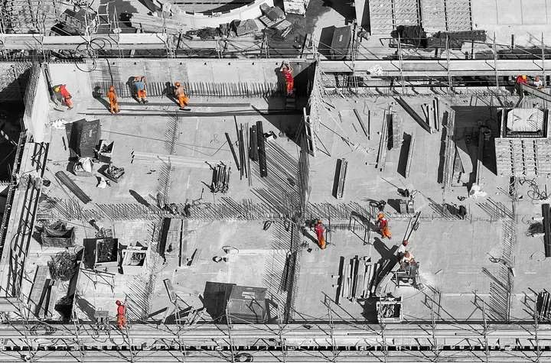
Concrete Strength Regression Machine Learning

Slide 2
TEAM MEMBERS
ML GROUP-16
PD16_270 –
Vinod Patil
PD15_148 – Pushpender Kumawat
PD16_ 228–
Prashant Mane
PD15_309 –
MD Saquib

Slide 3
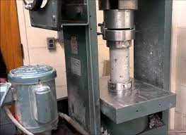
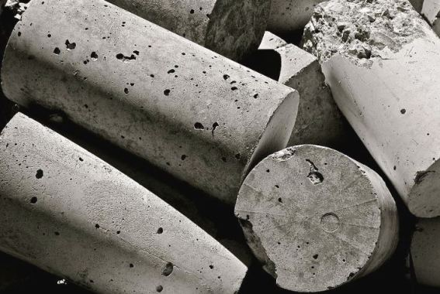
Introduction
The recommended wait time for testing the cylinder is 28 days to ensure correct results.
One way of reducing the wait time and reducing the number of combinations to try is to make use of digital simulations, where we can provide information to the computer about what we know and the computer tries different combinations to predict the compressive strength

Slide 4

Problem Statement
Predicting the Compressive Strength of Concrete given its age and quantitative measurements of ingredients.

Slide 5
Objective
Modeling of strength of high performance concrete using Machine Learning to reduce the wait time and number of combinations to try

Slide 6

Methodology
Importing modules
Handling null values
Dataset Description
Exploratory Data Analysis
Data Preprocessing &
Dividing independent and dependent variables
Splitting the data
Feature scaling
Model Building
Linear, Lasso, and Ridge Regression
Decision Trees
Random Forests
Conclusion
Challenges Faced

Slide 7



Slide 8
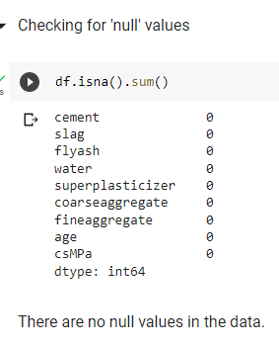
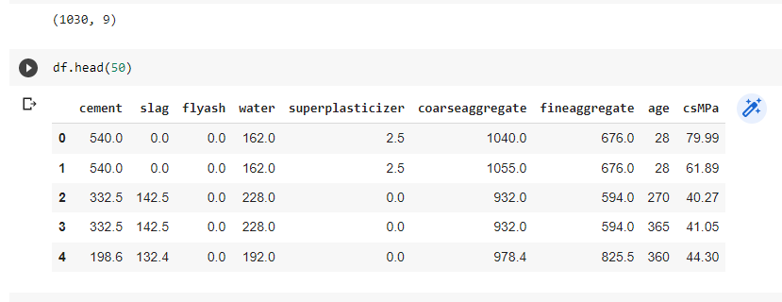
Dataset Description

Slide 9
cement: a substance used for construction that hardens to other materials to bind them together.
slag: Mixture of metal oxides and silicon dioxide.
Flyash: coal combustion product that is composed of the particulates that are driven out of coal-fired boilers together with the flue gases.
Water: It is used to form a thick paste.
Superplasticizer: used in making high-strength concrete.
Coaseseaggregate: prices of rocks obtain from ground deposits.
fineaggregate: the size of aggregate small than 4.75mm.
age: Rate of gain of strength is faster to start with and the rate gets reduced with age.
csMPa: Measurement unit of concrete strength.

Slide 10
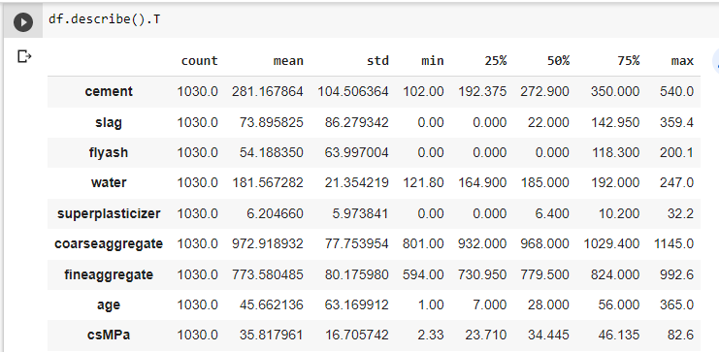
Exploratory Data Analysis(EDA)
Descriptive Statistics :-
Mean and the Median is nearly same for the Cement, Water, Superplasticizer, Coarseagg. , Fineagg. , Strength so we can say it is approximately normally distributed.

Slide 11
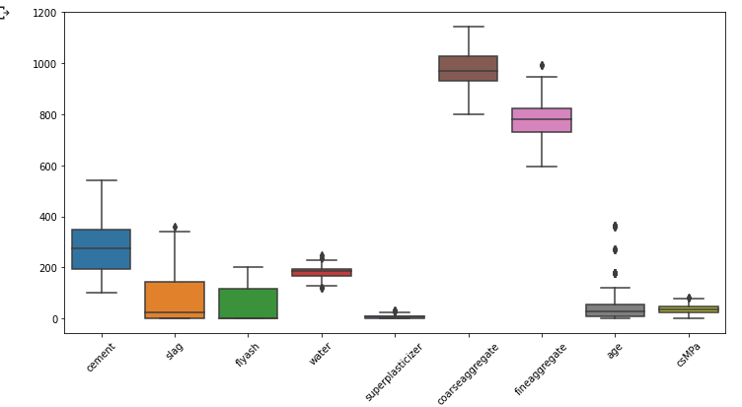
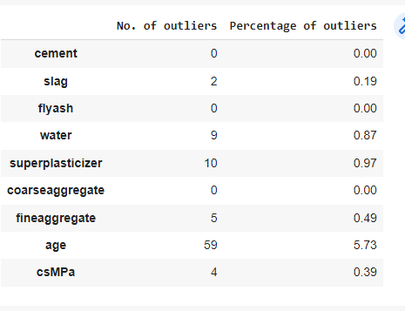
Presence Of Outliers

Slide 12
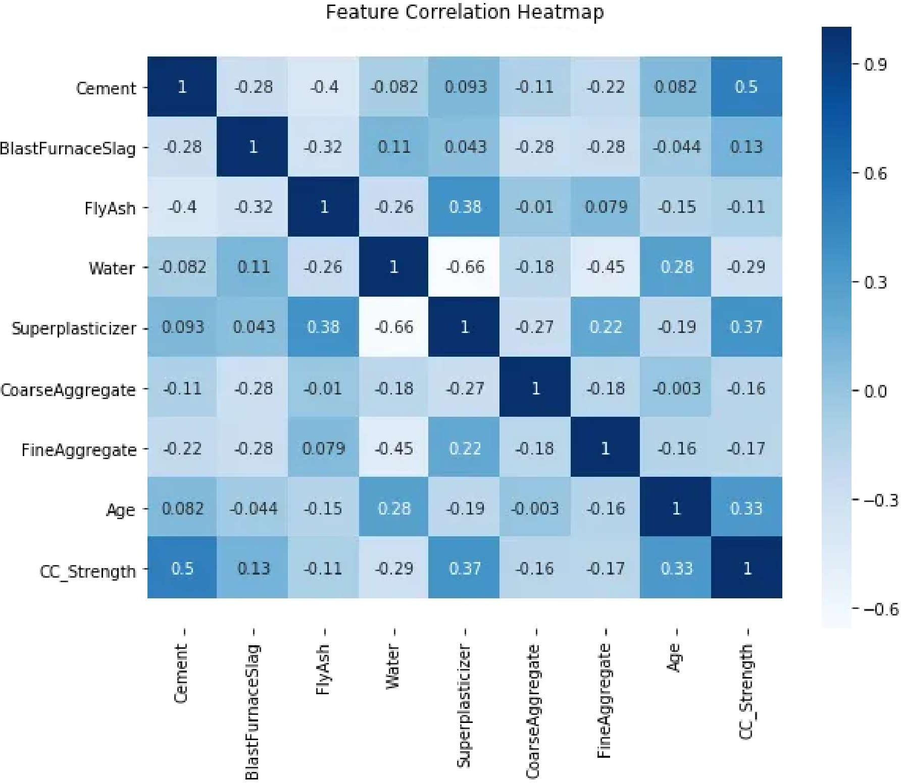
Feature Correlation Heatmap
Data Visualization

Slide 13
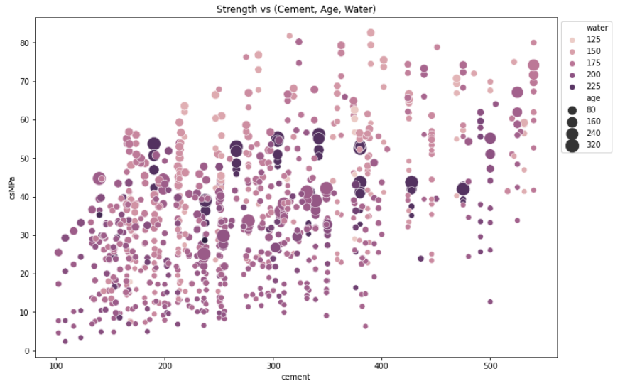
Strength vs (Cement, Age, Water)

Slide 14
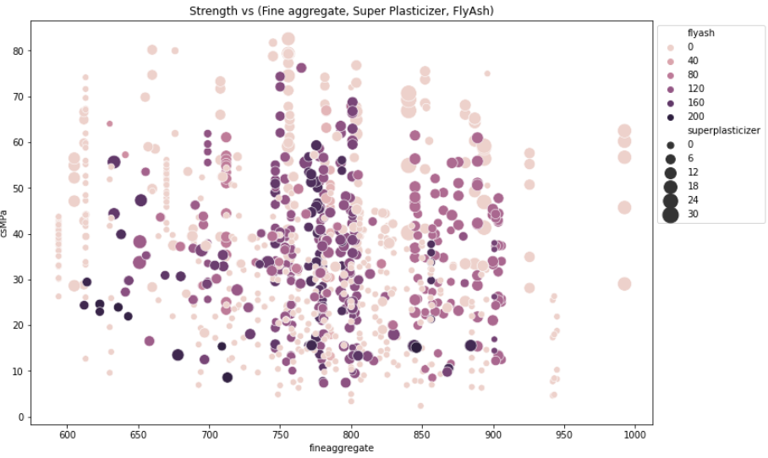
Strength vs (Fine aggregate, Super Plasticizer, FlyAsh)

Slide 15
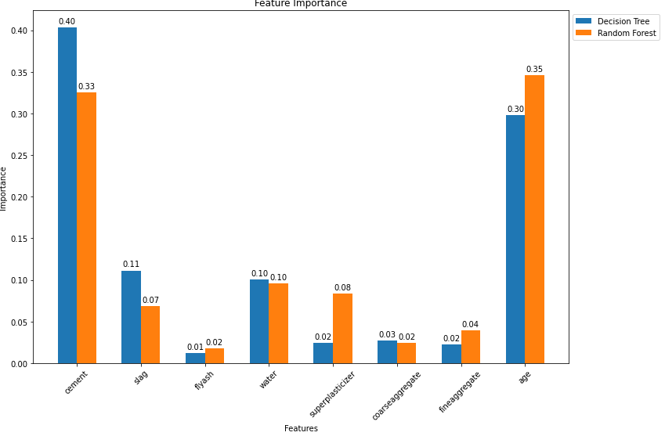
Feature Importance

Slide 16
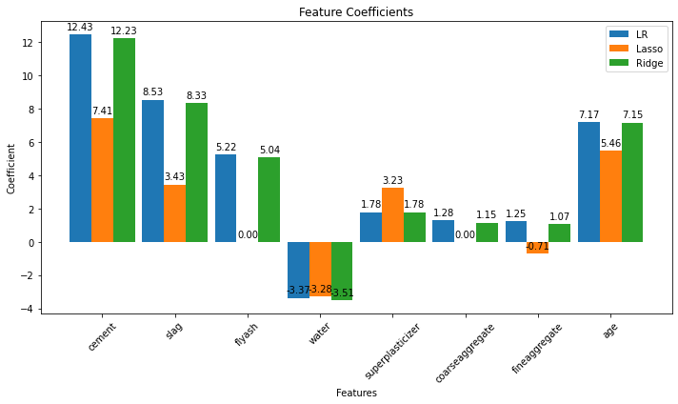

Slide 17
Model Building
Model | RMSE | MSE | MAE | R2
Random Forest Regressor | 4.54 | 20.61 | 3.09 | 0.92
Decision Tree Regressor | 5.89 | 34.71 | 3.85 | 0.86
Linear Regression | 10.06 | 101.11 | 8.18 | 0.59
Ridge Regression | 10.06 | 101.21 | 8.19 | 0.59
Lasso Regression | 10.81 | 116.76 | 8.87 | 0.52
Model | Score
Random Forest Regressor | 0.916090
Decision Tree Regressor | 0.858658
Linear Regression | 0.588310
Ridge Regression | 0.587893
Lasso Regression | 0.524606

Slide 18
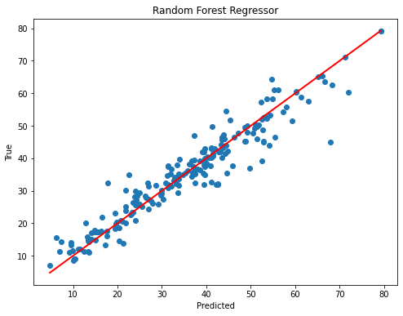
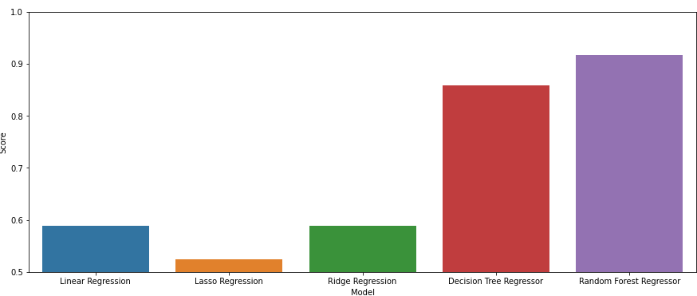
Random Forest Regressor

Slide 19
CHALLENGES FACED
All the concepts that we have used to complete the projects are new for our team for eg:- Performing Chi-square analysis to check whether there is a relationship between age and csMPa
And tune the hyperparameter of the best model
(Hyper-tuning Random Forest Regressor)
polynomial regression model
Deployment of Model
These are some concepts that we learn in a short duration and implement in our projects all have done their best effort to complete this project.

Slide 20
PLAN FOR PROJECT LAUNCH
PLANNING
Plan to make a model of nifty 50 which help us to predict the loss or profit in future.
Discussion
All our team members discuss the project.
Distribution
All the team members distributed their work according to their expertise.
Presentation
All the team members sit together and discuss all aspects of projects and put it in a presentation.
Submission
All completion of our work its time to submit the project to our guide.

Slide 21
Conclusion
We have analysed the Compressive Strength Data and used Machine Learning to Predict the Compressive Strength of Concrete. We have used Linear Regression and its variations, Decision Trees and Random Forests to make predictions and compared their performance. Random Forest Regressor has the lowest RMSE and is a good choice for this problem.

Slide 22

Thank you

